Slide 1


Reimagining child well being
Financing Mental health and equity in child serving systems
San Francisco state university
February 25th, 2022

Slide 2
The Social and Emotional Health of Children in California: Striking Increases in Utilization and Acuity
California’s Medi-Caid Program in Context
How MediCaid Works and What It Means for Cross Sector Collaboration: The 7 Essential MediCal Payors and The Need To Know Them All.
A Framework for Solutions
What’s Next and Where to Begin: Opportunity Mapping for Reimagining Behavioral Heath as support for healthy development informed by social justice principles
Questions and Discussion
DRINKING FROM A FIRE HYDRANT
2

Slide 3


WE HAVE A ONCE-IN-A-GENERATION OPPORTUNITY TO ADDRESS A CRISIS
Public opinion and policymaker agendas are aligned
Political Will: New administration has a stated focus on children’s well-being and has expressed interest and willingness to engage.
Community Support: Half (52%) of all Californians say their community does not have enough mental health providers to serve local needs.
Emerging Consensus and Consciousness: Of the impact of adversity, structural racism, and the pandemic on the social and emotional health of children.
TO TAKE ADVANTAGE OF THIS MOMENT IN TIME WE MUST:
Embrace the critical need to reform our financing and delivery models across child serving systems so that they are healing and relationship centered.
Adopt a concurrent but aligned paradigm shift across health care payors that deepens partnertship and brings new resources to services and supportst that reimagine mental health as a support for healthy development, not a response to pathology.
3

Slide 4

MEDICAID AS THE TIE THAT COULD BIND A FRAGMENTED CHILD SERVING SAFETY NET

Slide 5

DISTILLING THE STRUCTURE OF CHILD SERVING SYSTEMS IN CALIFORNIA
Federal
Children’s Mental Health
State
County / Local Agency
Child Welfare
Juvenile Justice
Early Childhood
Education
Regional Center
Notes:
DOMAIN: SYSTEMS CHANGE
Get yellow line to animate all in one step
Spending per beneficiary??
Children’s behavioral health touches all systems but is not integrated
1960’s era war on poverty structures defined by fragmentation and inability to make meaningful change in the face of multi-generational poverty.
Reference to the visual which shows not only funding in silos but lines also representing different legal mandates,
Not created to respond to the problems we most want to change. Bh as a pathology based framework created by white professionals that treat marginalized communities as problem rather than experts.
Everyone who is touching a child’s life is responsible for their well-being
Children’s BH is most often delivered in context of other child serving systems, but each system has a different definition of what the scope and nature of those services are – different mandates, language, and funding

Slide 6
THE SOCIAL AND EMOTIONAL HEALTH OF CHILDREN IN CALIFORNIA:
Striking Increases In Utilization And Acuity
How did we get here?

Slide 7
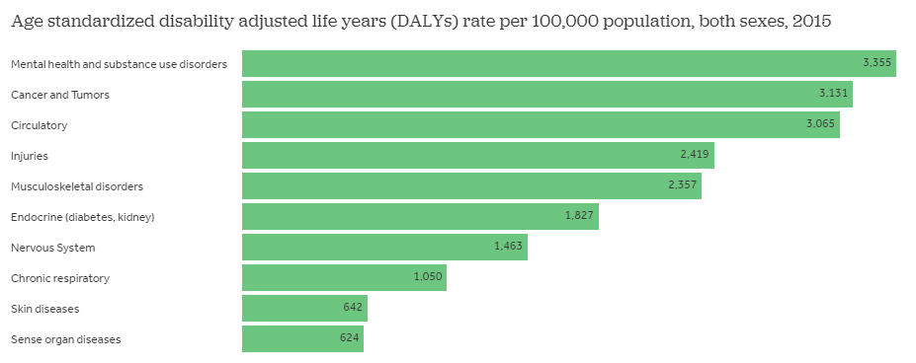
MENTAL HEALTH AND SUBSTANCE USE DISORDERS ARE THE LEADING CAUSES OF DISEASE BURDEN IN THE US
DALY, or the Disability-Adjusted Life-Year, is a metric that combines the burden of mortality and morbidity (non-fatal health problems) into a single number. One DALY can be thought of as one lost year of "healthy" life.
DALYs for a disease or health condition are calculated as the sum of the Years of Life Lost (YLL) due to premature mortality in the population and the Years Lost due to Disability (YLD) for people living with the health condition or its consequences: DALY = YLL + YLD
https://www.healthsystemtracker.org/chart-collection/current-costs-outcomes-related-mental-health-substance-abuse-disorders/#item-prevalence-mental-illness-among-adults-relatively-stable

Slide 8
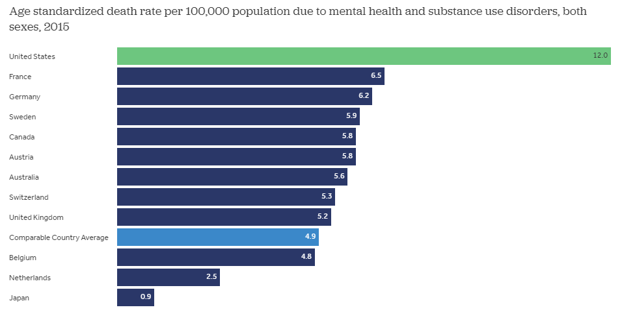
AMONG COMPARABLE COUNTRIES, THE U.S. HAS THE HIGHEST RATE OF DEATH FROM MENTAL HEALTH AND SUBSTANCE ABUSE DISORDERS
https://www.healthsystemtracker.org/chart-collection/current-costs-outcomes-related-mental-health-substance-abuse-disorders/#item-prevalence-mental-illness-among-adults-relatively-stable

Slide 9
THERE IS A CRISIS IN YOUNG PEOPLE’S MENTAL HEALTH
Consider the facts before COVID-19:
₄₃rd
104%
Increase in inpatient visits for suicide, suicidal ideation, and self injury
for children ages 1-17 years old, and 151% increase for children ages 10-14
50%
Increase in mental health hospital days
for children between 2006
and 2014
61%
Increase in the rate of self-reported mental health needs
since 2005
California ranks low in the country for providing
behavioral, social, and development screenings that are key to identifying early signs of challenges
9

Slide 10
THE “PRICE” IS HIGHER FOR BLACK AND BROWN CHILDREN
Many receive the wrong services at the wrong time…in restrictive or punitive settings.
81%
81% of children on medicaid are children of color.
Making Healing Centered Schools a reality isn’t simply a matter of tweaking access or programs…
It requires acknowledgment of how racism and poverty impact the social and emotional health of children
The suicide rate for black children, ages 5-12, is 2x that of their white peers.
2X
70% of youth in California's juvenile justice system have unmet behavioral health needs, and youth of color are dramatically over-represented.
70%
10

Slide 11
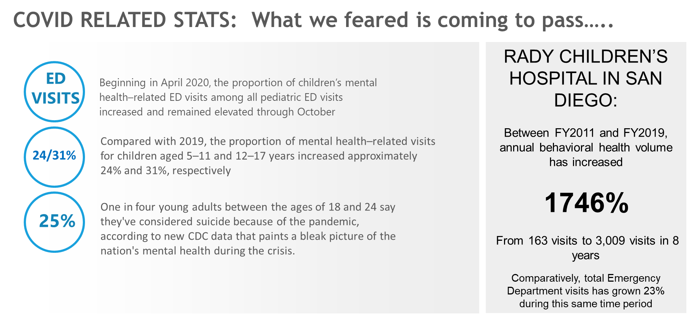
IMPACT OF COVID: What we feared is coming to pass…
ED
VISITS
Beginning in April 2020, the proportion of children’s mental health-related ED visits among all pediatric ED visits increased and remained elevated through October
Compared with 2019, the proportion of mental health related visits for children aged 5 to 11 and 12 to 17 years increased approximately 24% and 31% respectively
24/31%
One in for young adults between the ages of 18 and 24 say they’ve considered suicide because of the pandemic, according to new CDC data that paints a big picture of the nation’s mental health during the crisis
25%
Notes:
Since 2014, 30% increase in number of eligible children but percentage of children accessing care has stayed stable or declined (as a percentage of those eligible)

Slide 12

Adolescence Ages 12-18
37% of students with mental illness age 14 and older drop out of school
This is the highest drop out rate of any disability group
National Institute of Mental Health. Mental Health by the Numbers. 2015.

Slide 13
Half of all lifetime mental illness begin by age 14
Average delay between onset of symptoms
and intervention is 10 years
National Institute of Mental Health. Mental Health by the Numbers. 2015.

Slide 14

THE MEDICAL MODEL ISN’T THE ANSWER
Approximately 75% of mental illness manifests between the ages of 10 and 24. Since adolescents have the lowest rate of primary care utilization of any demographic group, it makes early warning signs difficult to detect.
Provider shortages at the PCP and mental health practitioner level compound the challenge.
Diagnosis-driven models are only appropriate for some children. Mental health must be reimagined and infused with contextual understanding of the SDOH and ACES.
How did we get here?
We have no common framework for defining and understanding behavioral health among and between public systems and clinical care providers.
Our public systems are deeply fragmented and under-resourced. Commercial payers have not effectively partnered with child-serving systems.
A lack of clarity over whether youth mental health care is an essential benefit or a public utility prevents commercial payers from fully engaging.
Our definition of medical necessity is outdated and inconsistent with emerging trends and evidence regarding the impact of trauma and adversity on social and emotional health.
The field is young. Many clinical modalities with widespread application are less than 20 years old.

Slide 15
CALIFORNIA’S MEDICAL PROGRAM IN CONTEXT:

Slide 16
MEDICAID BY THE NUMBERS
1/3 of Californians are covered by Medi-Cal (California’s version of MEDICAID), which underinvests in their mental and behavioral health. Children are historically the most underfunded.
Total Dollars: $105.2 Billion
Total Californians: 39 Million
9%
BEHAVIORAL HEALTH:
$12 BILLION
MEDI-CAL
COVERED:
13 MILLION
33%
16
*Current budget estimates show a 25% increase in Medi-Cal enrollees due to COVID-19

Slide 17
MEDICAID BY THE NUMBERS – CALIFORNIA’S KIDS
Almost 6 out of 10 children are covered by Medi-Cal. They are served by county administered Specialty Mental Health Plans (MHP) and Medi-Cal Managed Care Organizations (MCO’S)
MCO Total Served Annually: 90,000 Kids
MHP Total Served Annually: 152,409 Kids
Total California Children: 10 Million
COMMERCIALLY INSURED:
4 MILLION
MEDI-CAL COVERED:
6 MILLION
ELIGIBLE & NOT ACCESSING: 96%
17

Slide 18
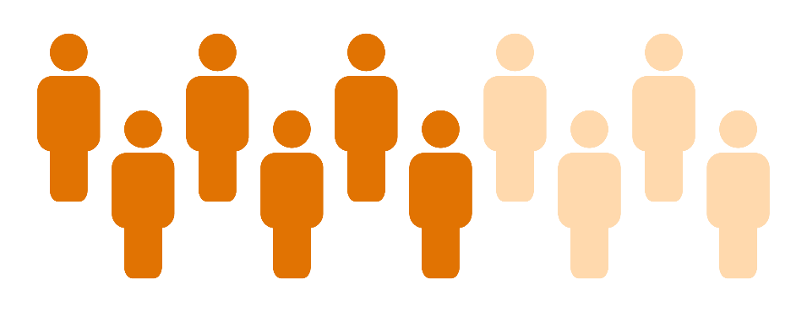

MediCal (California’s Version of Medicaid) is largest funder of health and social services in California’s Safety Net:
6 million of California's 10 million children are now covered by Medi-Cal and the EPSDT entitlement
(a 30% increase over last five years)
Everyone under 21 living in a family that makes less than 250%FPL qualifies for MediCal
CALIFORNIA IS GROUND ZERO FOR INCOME INEQUALITY:
7 OUT 10 CHILDREN BORN INTO POVERTY WILL NEVER GET OUT

Slide 19

ELIGIBILITY FOR MENTAL HEALTH SERVICES HAS INCREASED,
BUT ACCESS REMAINS LIMITED:
Less than 5% get access to any care, and only 3% are in ongoing care.
19

Slide 20
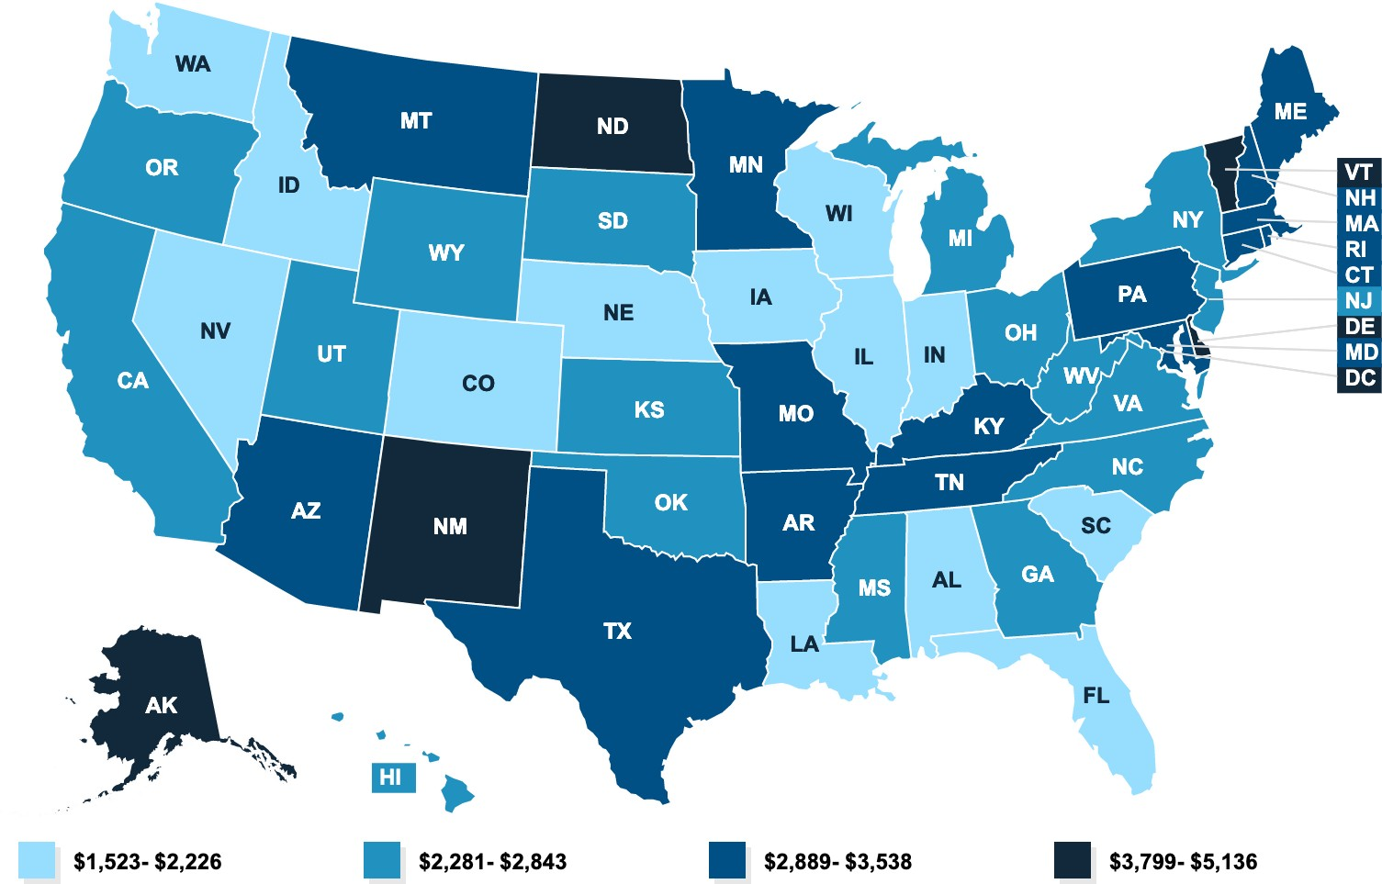
DRAMATIC UNDER-INVESTMENT IN CHILDREN
California is in the bottom 1/3 nationally for health spending at $2,500 per child enrollee.
Medicaid Spending per Child
FY 2014
Children represent 42% of enrollees but only 14% of all expenditures.
California ranks 44th in the nation of in access to care for children.
California operates the largest MediCaid Program in the nation—April 2019 Audit exposed significant underperformance under the EPSDT Mandate and Bright Futures Guidelines.
20

Slide 21


SCHOOLS CAN (and must) BE ESSENTIAL ACTORS IN OUR RESPONSE:
Schools are ground zero for the youth mental health crisis, and our collective failure at supporting them has contributed to the marginalization of black and brown children.
The Health Care System Needs Schools: Children ages 8-18 have the lowest rate of primary care utilization of any demographic in MediCal—and 75% of mental illness manifests in adolescence. Not only are schools essential actors in a reformed mental health system that overtly addresses healing, justice, and structural racism, but they are also essential service setttings for children with clinical needs.
The Finances Align: Schools have what the publicly funded Medicaid system needs….access to kids and the non-federal dollars to claim against (CPE).
21

Slide 22
\
How MediCaid Works and What It Means for Cross Sector Collaboration:
The 7 Essential MediCal Payors and The Need To Know Them All

Slide 23


THE FEDERAL MATCH IS GUARANTEED:
=
$
$
a Medicaid Expenditure
CPE
FFP
Certified Public Expenditure (CPE) = A governmental entity, including a governmental provider (e.g., county hospital, local education agency) incurs an expenditure eligible for FFP under the state’s approved Medicaid state plan (DHCS definition).
Federal Financial Participation (FFP) = The federal share of Medicaid dollars when all state and federal requirements are met.

Slide 24


THE MEDICAID MAP: WHO PAYS FOR FEDERALLY ENTITLED SERVICES TO CHILDREN AND FAMILIES
$
Federal Government
State of CA
Distributed through Federal departments with funding authorized by Congress (FFP/Match)
Acting as pass-through, enhancer, or reconciler of funding—sometimes providing it, sometimes certifying
Health Plans (MCO)
CAPITATION
County Mental Health Depts (MHP)
CPE
School Districts (LEAs/SELPAs)
CPE
Community Health Centers FQHC
PPS
Dept. of Heath (LGA)
CPE
Hospital UC/PH
IGT
Regional Center
CPE
Notes:
Reasons system doesn’t work is because it lacks transparency on spending of medicaid

Slide 25
WHO ARE THE MOST IMPORTANT PAYORS FOR CHILD SERVING SYSTEMS?
$
Federal Government
State of CA
Distributed through Federal departments with funding authorized by Congress
Acting as pass-through, enhancer, or reconciler of funding
Health Plans (MCO)
CAPITATION
County Mental Health Depts (MHP)
CPE
School Districts (LEA BOP/MAA)
CPE
Community Health Centers (FQHC)
PPS
Dept. of Heath (LGA TCM/MAA)
CPE
Hospital UC/PH
(P14)
IGT
Regional Center
CPE
Notes:
Reasons system doesn’t work is because it lacks transparency on spending of medicaid

Slide 26
HOW TO MAKE IT WORK:
BUBBLE GUM, SHOESTRING, FEDERAL MATCHING FUNDS, AND A CULTURE OF COLLABORATION

Slide 27

THERE IS HOPE
There are new and emerging practices.
Integration is possible - within health systems and among child serving systems.
It is past time.

Slide 28

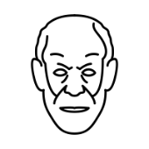



THE EVOLUTION OF PSYCHOTHERAPY: HOW ARE BEST PRACTICES APPLIED?
Current practices consolidate cognitive and behavioral therapies and apply them to emerging delivery models focused in support for healthy development, not in response to pathology.
WE ARE HERE
Racial Justice and Social Capital Building Strategies in Emerging Delivery Models: Resisting Pathology
WAVE 1
Psychoanalysis
(e.g. Freud, Jung)
WAVE 2
Behavior
Modification
(e.g. Skinner, Watson)
WAVE 3
Humanistic/Experiential Psychotherapy
(e.g. Erikson, Frankl)
WAVE 4
Cognitive
Psychotherapy
Expanding Eligible Providers
Community Defined Pracitces
Indigenous and Spiritual Practice Integration
Mindfulness
Trauma and Adversity
Family Resource Models
Schools
Telepsychiatry
Co-location
Peer Support
Social Models
Social Justice/Civic Engagement
1899-
Freud’s The Interpretation of Dreams
1913
Watson’s Psychology as the Behaviorist Views It
1928-1930
Frankl began counseling students for free in Vienna
1960s: CBT
(Cognitive Behavioral Therapy)
1913
Jung establishes Analytical Psychology
1938
Skinner publishes Behavior of Organisms
1933
Erikson becomes first U.S. child psychoanalyst
1970s: Narrative Therapy
1953
Behavior Research Laboratory
1959
Frankl’s book became Man’s Search for Meaning
1980s: DBT
(Dialectical Behavior Therapy)
1921
Jung publishes Personality Types
1968
Applied Behavior Analysis
1969
Erikson publishes Gandhi's Truth, showcasing ego psychology
1996: MST
(Multisystemic Therapy)

Slide 29

Redefining MediCal Necessity
Expanding Eligible Providers
Community Defined Practices
Indigenous and Spiritual Practice Integration
Mindfulness
Trauma and Adversity
Family Resource Models
Schools
Telepsychiatry
Co-location
Peer Support
Social Models
Social Justice/Civic Engagement

Slide 30
We have new science and emerging practices that demonstrate the power of behavioral health services.
If we have the courage, will, and skill to apply this work to improve the lives of children and families…
Interventions that increase resilience can have a moderating effect on depressive symptoms for children exposed to trauma.
Targeted individual and group interventions to reduce risk factors and increase protective factors can prevent the onset of childhood depression and anxiety.
Individual, group, and family treatment interventions can relieve symptoms of traumatic stress; improve cognitive, behavioral, social and emotional health; and improve children’s performance in school.
THE RIGHT INTERVENTIONS CAN CHANGE THE TRAJECTORY
Wingo, A., Wrenn, G., Pelletier, T., Gutman, A., Bradley, B. and Ressler, K. 2010. “Moderating effects of resilience on depression in individuals with a history of childhood abuse or trauma exposure.” J Affect Disord. 126(3):
411-414. Retrieved from https://www.ncbi.nlm.nih.gov/pmc/articles/PMC3606050/
Lawrence, P.J., Rook, S., Creswell, C. 2017. “Review: Prevention of anxiety among at-risk children and adolescents-a systematic review and meta-analysis.”Child and Adolescent Mental Health.; 22(3): 118–130
Saxena, S., Jane-Llopis, E., Hosman, C. 2006. “Prevention of mental and behavioural disorders: implications for policy and practice.” World Psychiatry. Feb; 5(1): 5-14.
Substance Abuse and Mental Health Administration. 2018. Helping Children and Youth Who Have Traumatic Experiences. Retrieved from: https://www.samhsa.gov/sites/default/files/brief_report_natl_childrens_mh_awareness_day.pdf
The National Child Traumatic Stress Network. “Treatments that Work.” Retrieved on May 13, 2018, from: https://www.nctsn.org/treatments-and-practices/treatments-that-work/interventions

Slide 31
And State and Federal
Leaders Have Made an
Unprecedented
Commitment:

Slide 32



UNPRECDENTED INVESTMENT
IS COMING TO SCHOOLS AND SYSTEMS:
Managed Care Plans ($400 million)
Competitive Grants Program ($550 Million)
MHSA SSA funding ($250 million)
Workforce including BH Coaches ($800 Million)
BH Virtual Platform: ($750 Million)
Expanding Evidence Based Programs (429 Million)
FUNDING OPPORTUNITIES FOR SOCIAL, EMOTIONAL AND MENTAL HEALTH IN SCHOOLS AND SYSTEMS:
YBHI
4.4 Billion
Expanded Learning Opportunity Grant Program (4.6 Billion)
ELOP ongoing 1.75 (proposed at 4.4)
Learning Loss Mitigation (5.3 Billion)
Community School Partnership Grant Program ($3B)
Educator Effectiveness Grant (1.5B)
HCSB/Special Ed/Other....(1.5 Billion)
GOV BUDGET
15+ Billion
- ESSER I (CARES Act) - $1.6 billion
- ESSER II (CRRSA Act) - $6.7 billion
- ESSER III (ARP Act) - $15.1 billion
FEDERAL STIMULUS
$23.4B

Slide 33

$ 4.4 Billion Youth BH Initiative:
01
06
02
05
Behavioral Health Service Virtual Platform: DHCS, $749.7 M
School Behavioral Health Counselor + Behavioral Health Coach Workforce: OSHPD, $352M
School-Linked Behavioral Health Services: DHCS/DMHC, $950M
07
Broad Behavioral Health Workforce Capacity: OSHPD, $448M
03
Develop and Expand Age-Appropriate, Evidence-Based Behavioral Health Programs: Agency/DHCS, $429M
08
Pediatric, Primary Care And Other Healthcare Providers: DHCS, $50M
09
Comprehensive And Culturally And Linguistically Proficient Public Education And Change Campaign: CDPH + OSG, $100M
04
Building Continuum of Care Infrastructure: DHCS, $310M
Plan Offered Behavioral Health Services: DHCS, $800M
10
Oversight, Coordination, Convening, And Evaluation: DHCS, $70M
33

Slide 34
And Beyond Funding
Commitments…
There are real signs
of Progress

Slide 35
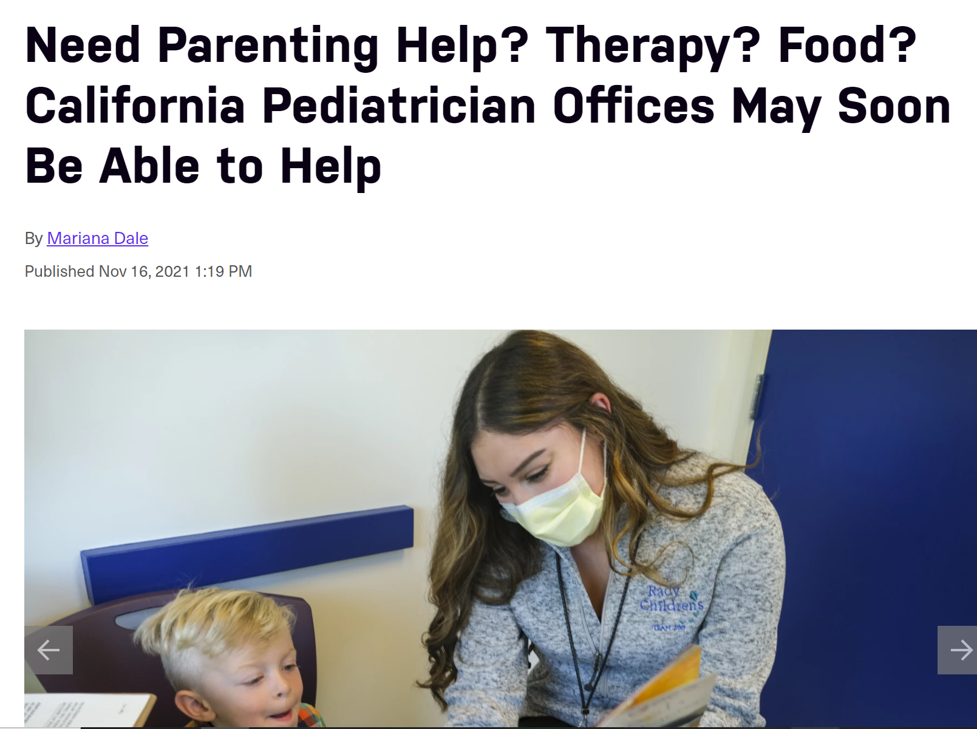
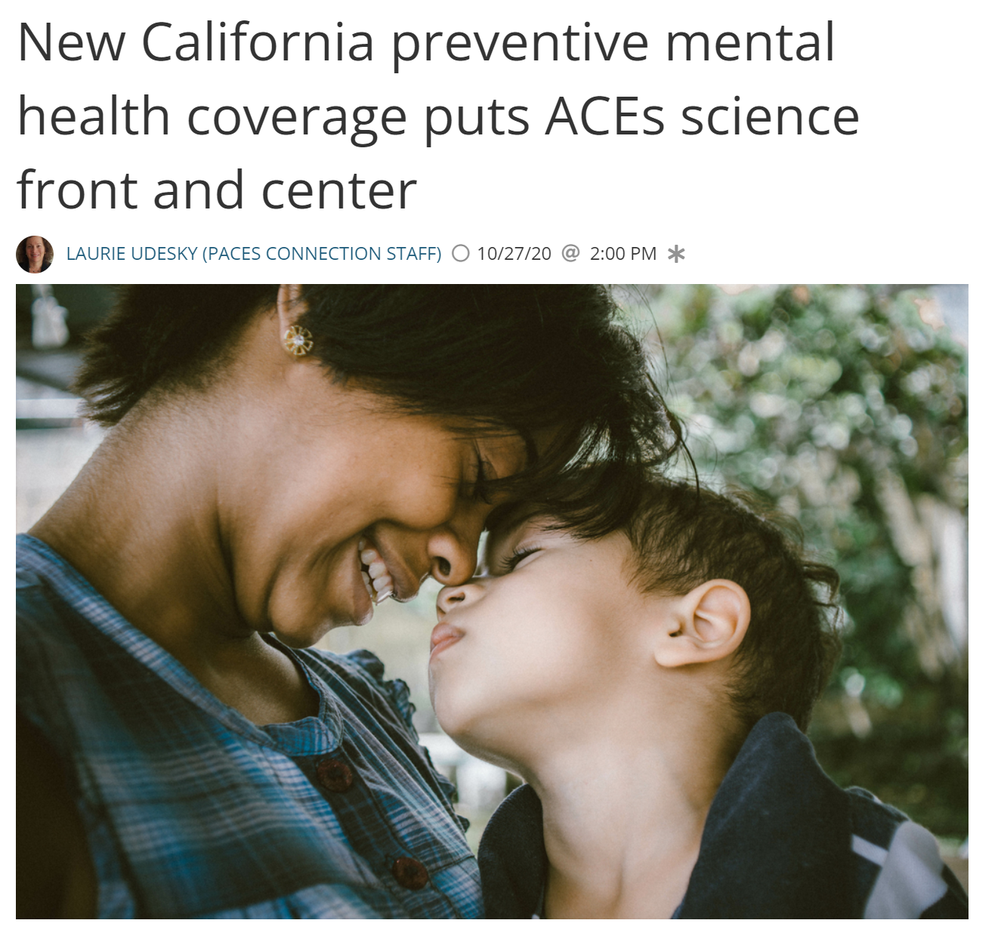
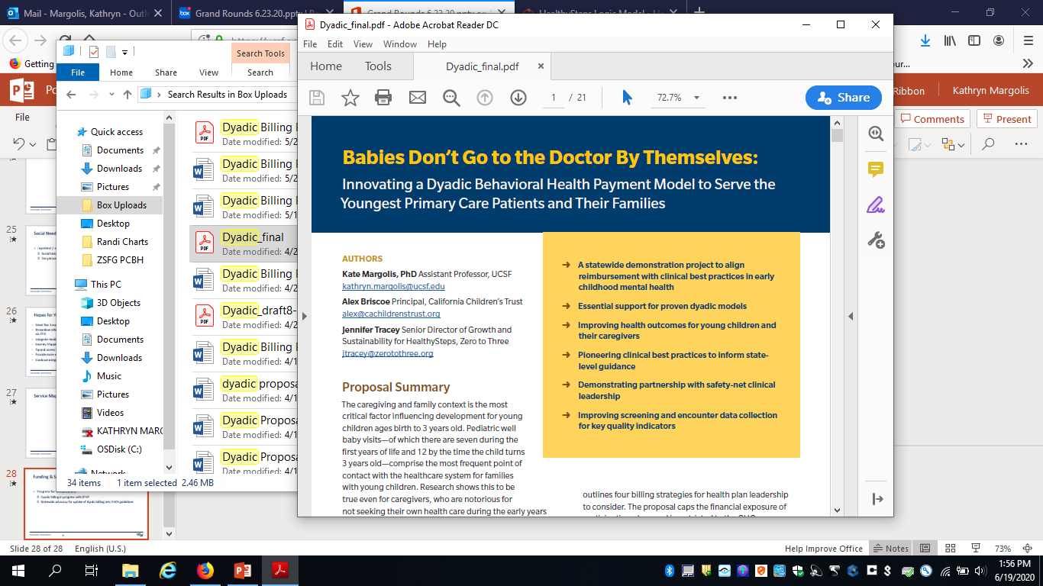
MEDICAL NECESSITY:
THE REMOVAL OF DIAGNOSIS AS A PRE-REQUISITE FOR CARE IN COUNTY MENTAL HEALTH PLANS AND MEDICAL MANAGED CARE:
Notes:
KATE
Credit Ayelet
Explain the billing problem
Contract with SFHP & Anthem for code expansion
SFHP: All WCV Z-codes paired with BH CPT codes
Anthem: Still developing
CHC will:
Enroll 300 Tier 3 families
Credential HSS with NSMH payer
Provide Tier 2 & 3 visits; Submit claims
NSMH payer claims data

Slide 36


SYSTEMS CHANGE IN PRACTICE
Federal, state, and local systems leaders are increasingly active at the nexus of health and education.
Community Schools Act:
LEA Billing Option Program State Plan Amendment (SPA) Implementation
MHSA Mental Health Student Services Act
DHCS Family Therapy Medical Necessity Guidance and Dyadic Benefit Design
ASES Funding Expansion and Leveraging Opportunities
CalAIM (Medi-Cal Reform Initiative)
Youth BH Initiative
MediCal Managed Care Re Procurement
HERE ARE REFORM INITIATIVES TO TRACK:

Slide 37
THIS IS THE TRUST’S FRAMEWORK FOR SOLUTIONS
Shifting agency (who does the work) and power (who gets paid to do it) in child serving systems
Increase state and county spending, and fully claim the
federal match
Expand
Access and
Participation
Increase state and county spending, and fully claim the
federal match
Equity
+
Justice
Increase transparency and accountability
Maximize
Funding
Reinvent
Systems

